Slide 1
Section 4.4 Sine Law and Cosine Law
© Copyright all rights reserved to Homework depot: www.BCMath.ca

Slide 2
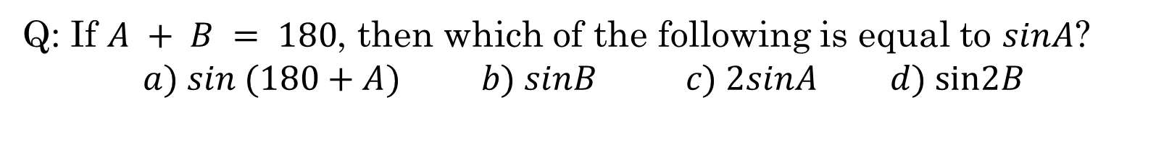
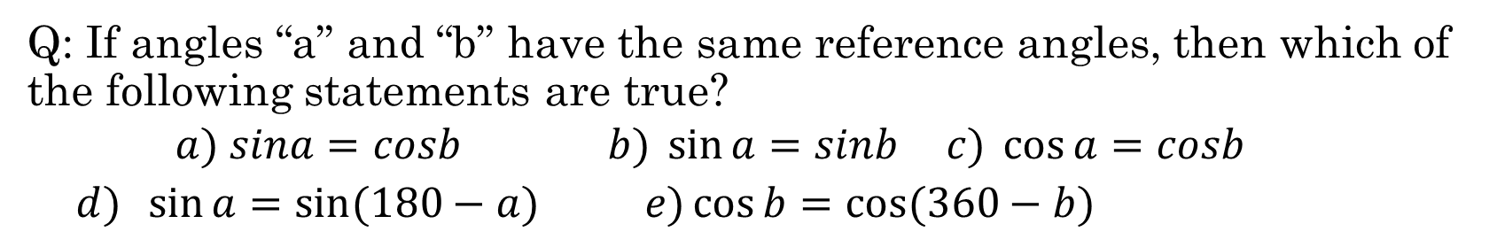
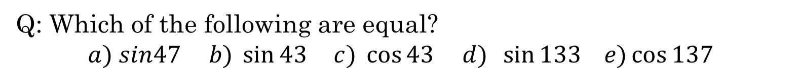
Q: Which of the following are equal?
$$a) sin47 b) \sin{43} c) \cos{43 d) \sin{133 e)\cos{137}}}$$
Q: If $A + B = 180$, then which of the following is equal to $sinA$?
$$a) sin (180+A) b) sinB c) 2sinA d) sin2B$$
Q: If angles “a” and “b” have the same reference angles, then which of the following statements are true?
$$a) sina=cosb b) \sin{a=sinb} c) \cos{a=cosb }$$
$d) \sin{a=\sin{(180−a)} e)\cos{b=cos⁡(360−b)}}$

Slide 3
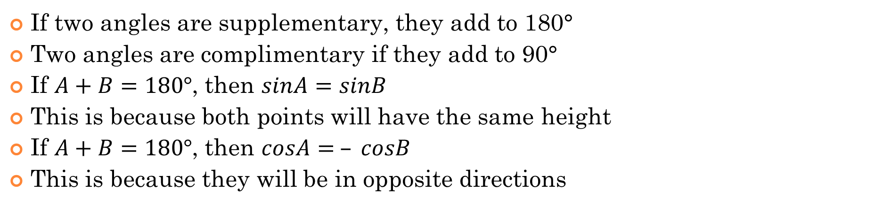
Properties with Supplementary angles
If two angles are supplementary, they add to 180°
Two angles are complimentary if they add to 90°
If $A+B=180°$, then $sinA=sinB$
This is because both points will have the same height
If $A+B=180°$, then $cosA= – cosB$
This is because they will be in opposite directions
Negative direction
Positive direction

Slide 4
Sine Law and Cosine Law:
When given a triangle that is “NOT” a right triangle, you can solve for the missing sides and angles using the “Sine” law and “Cosine” law
Side: a, b, d (lower cases)`
Angles: A, B, D (Upper cases)
NOTE: sides/angles are named based on being the opposite of each other
Sine Law can only be used if you are given “one side” with the opposite angle, ie: angle “A” and side “a” together…
Cosine Law can be used when you have: SSS or SAS
SINE LAW:
COSINE LAW:

Slide 5
When using the sine law or cosine law to solve a triangle, indicate which sides and angles are given first
In this triangle, you DON”T have one of the angles with the opposite side. Instead, you have SAS, so use the “Cosine Law”
In this triangle, you have one of the angles with the opposite side, so use the “Sine Law”
Multiply &
Solve for “X” Cross

Slide 6
Practice: Indicate whether you should use the “sine” or “cosine” law to find the length of the missing side:
Ex: Use Trig to Find the Area of the Triangle:

Slide 7
In this triangle, you have angle “A” with the opposite side “a” , so use the “Sine Law”
You have a SAS triangle, so use the “Cosine Law”
You have a side (17) with opp angle, so use the “Sine Law”

Slide 8
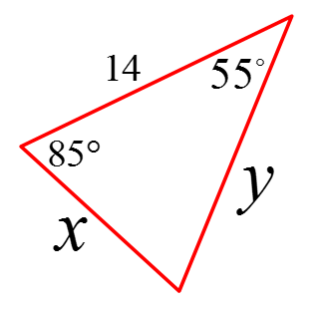
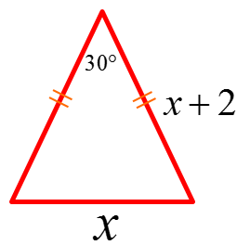
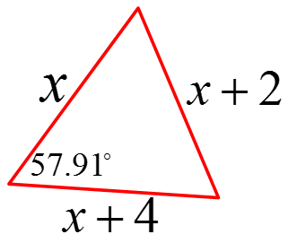
Sine law OR Cosine Law?
This is an isos. triangle
With 3 sides given in terms of “x”, Cosine Law!
With 2 angles given, the 3rd angle can be easily found!
Now we have an angle with an opp. Side → SINE LAW!
You can’t have a negative length, so take the positive value !!!

Slide 9
With 3 sides given in terms of “x”, use the cosine law to solve for “x”
Since “x” can only be positive, take the “minus” only

Slide 10

Practice: Find the values of angle $∅1 and ∅2 \text{[}\text{courtesy} \text{of} \text{Mr}\text{. }\text{Chang}\text{]}$
The challenge with this question is that $∅1$is actually an obtuse angle. Most students will not catch this. So one way to check if the angle is obtuse is to Re-use the cosine law!

Slide 11
Practice: FIND THE AREA OF THE TRIANGLE
Find one of the angles
Use the angle to find the height of
the triangle
© Copyright all rights reserved to Homework depot: www.BCMath.ca

Slide 12
Solving For missing Angles:
There are two main challenges when solving for angles:
With the sine law, be careful with obtuse angles, leads to the ambiguous case – if an angle is obtuse, it means that it is bigger than 90° and will be in quadrant 2
When solving angles with the cosine law, most mistakes are caused by algebraic errors, remember BEDMAS
Angle “B” is an OBTUSE angle,
So it must be in Quadrant #2!!
So if an angle is obtuse, find the angle in quadrant 2!! If you are unsure if it is obtuse or not, solve both cases

Slide 13
Here is an example with solving for an angle using the cosine law:
This is a case of SSS, where all three sides are given. So use the cosine law to find the missing angle
Here’s where most students make an algebraic mistake:
Mistake of adding these terms
You can’t add these three terms b/c the 144 is multiplied to cosϴ
Watch what to do next!

Slide 14
Ex: Solve for the missing angle in each triangle:
Ex: The angle of elevation to the top of the tower is 43°. If you travels 100m closer, the angle is 75°. How tall is the tower? Assume the person is about 1.5m tall.

Slide 15
Formula
Angle “B” is an OBTUSE angle,
So it must be in Quadrant #2!!

Slide 16
Use the cosine law to find the value of “x”
Use the cosine law to find the 3rd side “x”
Now use the sine law to find the value of the missing angle
Now use the Sine law to find the missing angle
With 20 being the longest side, the angle should be obtuse. Q2

Slide 18
Ex: The angle of elevation to the top of the tower is 43°. If you travels 100m closer, the angle is 75°. How tall is the tower? Assume the person is about 1.5m tall.
Make a Triangle and Gather Info
Find the Hypotenuse of the triangle
Use the Hypotenuse to find the opposite side
Height of
the Tower
© Copyright all rights reserved to Homework depot: www.BCMath.ca

Slide 19
Ex: Given that the smaller triangle is inscribed in a circle,
i) What is the area of the circle?
ii) If the perimeter of the larger triangle is 70 units, what is it’s area?

Slide 20
When given a triangle with all three vertices on the circumference of a circle, you can use the following formula to find the Diameter and Radius of the circle
To find the radius or diameter, you only need ONE set of the
angle with the opposite side!
PROOF:

Slide 21
Ex: Given that the smaller triangle is inscribed in a circle,
i) What is the area of the circle?
ii) If the perimeter of the larger triangle is 100 units, what is it’s area?

Slide 22
Sine LAW with Non-Bisecting Angles:
Suppose you have a triangle with an angle that is cut into two as shown:

Slide 23
Challenge: CNML 1980
Find the ordered pair of real numbers (x,y) for which in triangle ABC, sin A : sin B : sin C = 4 : 5 : 6, while the ratio of cos A: cos B : cos C = x : y : 2
Answer:

Slide 24
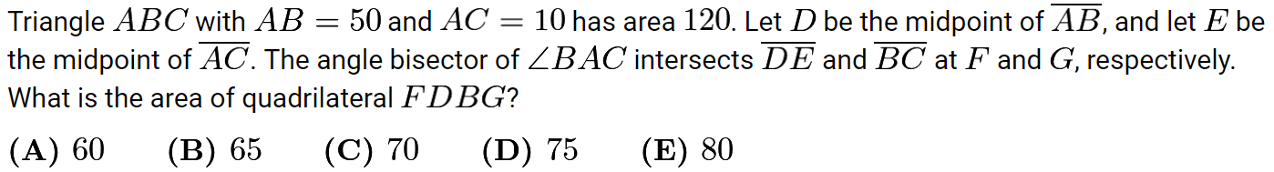
The area of the left triangle is
5times the right triangle
The area of the Blue triangle
is 100. Red triangle is 20
The area of this purple triangle
is ¼ of the big triangle
Area is 30
The Area of green triangle is 25
The Area of quadrilateral FDBG is:

Slide 25
Proof For the Sine Law
If we use another altitude for
angle A, we can solve for the
other part of the sine law
© Copyright all rights reserved to Homework depot: www.BCMath.ca

Slide 26
Proof For the Cosine Law
© Copyright all rights reserved to Homework depot: www.BCMath.ca

Slide 27
Romanian Triangle Question:
Hint: Can you find the ambiguous case of the sine law?

Slide 28
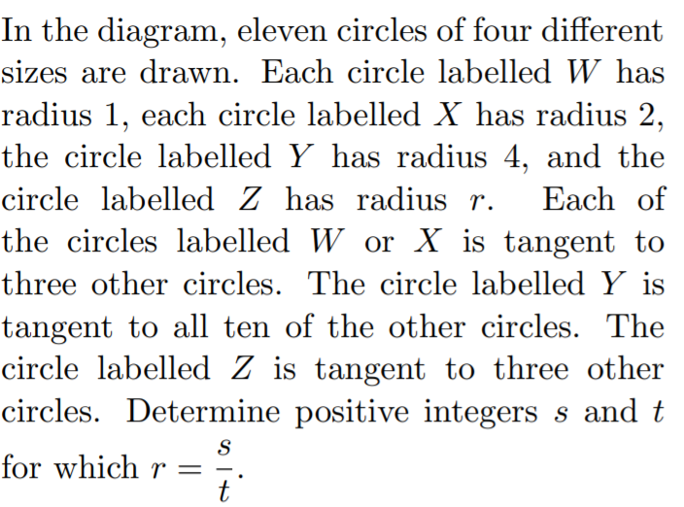
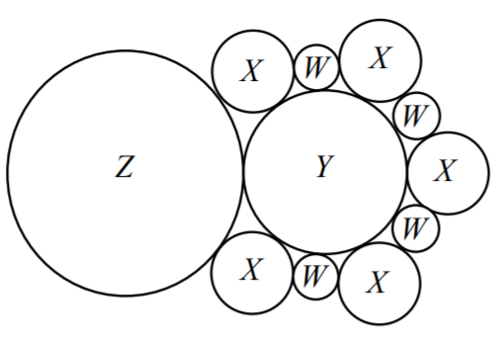
Q: Find the ordered pair of real numbers (x,y) for which in triangle ABC, sin A : sin B : sin C = 4 : 5 : 6, and while the ratio of cos A: cos B : cos C = x : y : 2
(CNML 1980)

Slide 29
Q: Find the ordered pair of real numbers (x,y) for which in triangle ABC, sin A : sin B : sin C = 4 : 5 : 6,
and while the ratio of cos A: cos B : cos C = x : y : 2
(CNML 1980)
Since the sides of the triangle are not given, we can allow a,b,c to be these given lengths OR multiples of them… ie: a=4k, b=5k, c=6k
Now use the cosine law to find the value of cosA, cosB, and cosC

Slide 31
Proof For the Sine Law
If we use another altitude for
angle A, we can solve for the
other part of the sine law
© Copyright all rights reserved to Homework depot: www.BCMath.ca

Slide 32
Proof For the Cosine Law
© Copyright all rights reserved to Homework depot: www.BCMath.ca

Slide 33
